Slide 1
Migrating ProRes/MOV to FFV1/MKV
Kieran O’Leary - IFI Irish Film Archive
Budapest 2019-12-05
@kieranjol #nttw4

Slide 2
Why normalise lossy video to lossless?
FFV1/MKV - Free/Open
May already be designated preservation master format
Move away from proprietary formats
Safeguard your collections?????

Slide 3
Dangers
What if ‘significant properties’ are lost?
Also what even are those significant properties?
How to validate correct normalisation
Is Framemd5 enough?
File size increase (depends on input, but we’ve seen 35-40% increase)

Slide 4
Testing
Raelene Casey, Gavin Martin and Kieran O’Leary
A few hundred SD ProRes/PCM/MOV/tmcd files
Normalise to FFV1/MKV
Do Framemd5s match? - YES!
Lossless? - Yes!

Slide 5
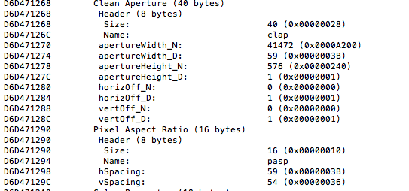
41472/59 * 59/54 = 768
768/576 = 1.333333333 :)

Slide 6
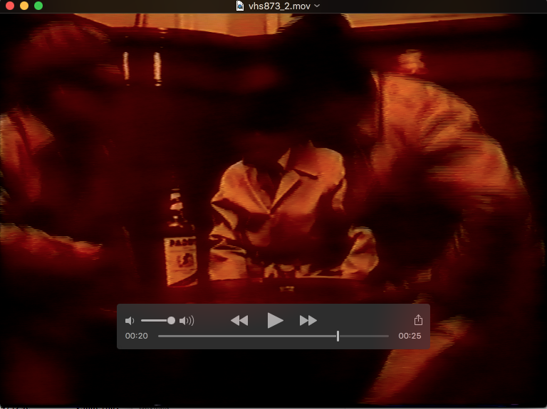

Slide 7
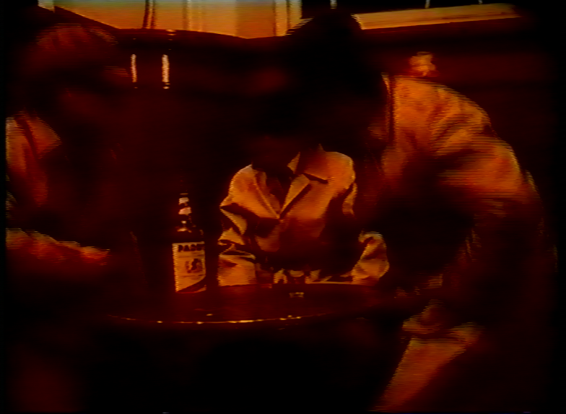

Slide 8
Aspect ratio/Crop
Some MOV files contained clean aperture metadata (clap)
Crop defined which displays correctly in QuickTime Player
Clap metadata not mapped to Matroska PixelWidth.. But it can!
Financial support needed to add this support
By default, ffmpeg applies 59/54 PAR, ignoring the crop
720*(59/54) = 786.7777777
786.777 / 576 = 1.364:1
Different aspect ratio 1.33333 vs 1.364:1

Slide 9
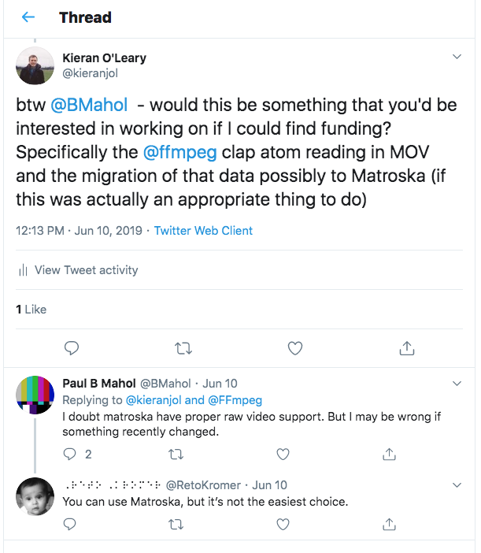

Slide 10
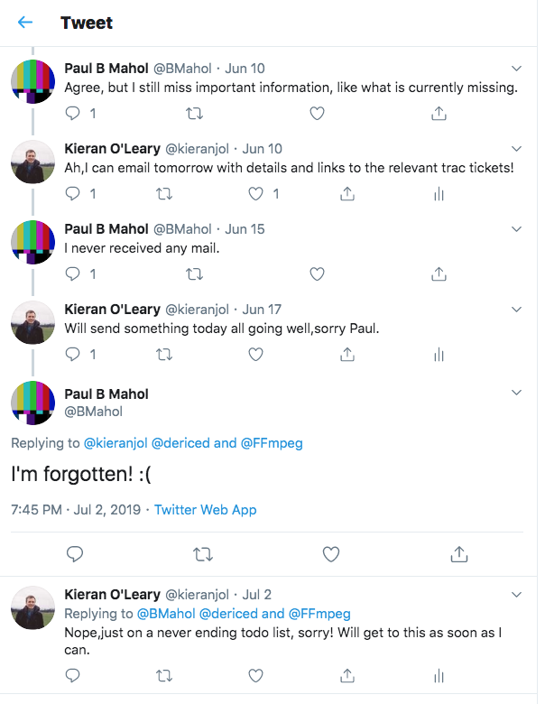

Slide 11
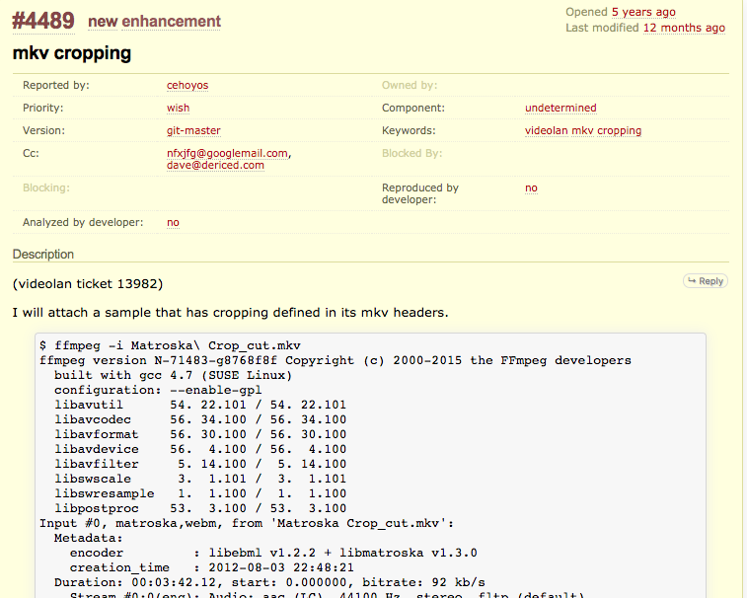

Slide 12
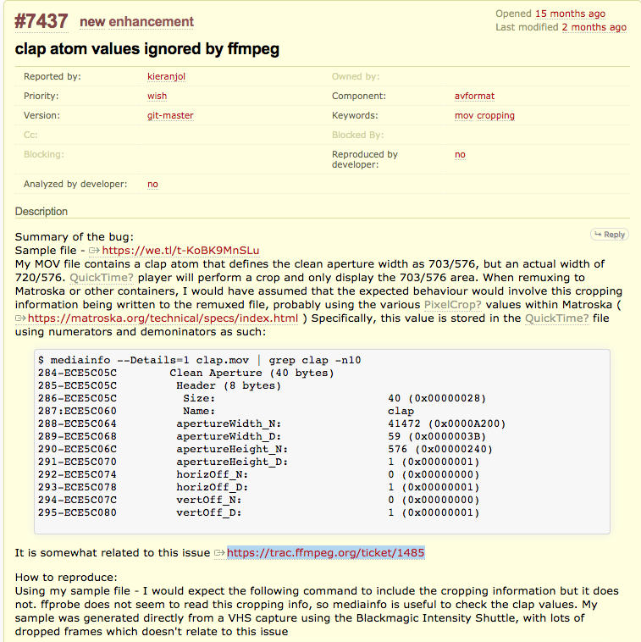

Slide 13
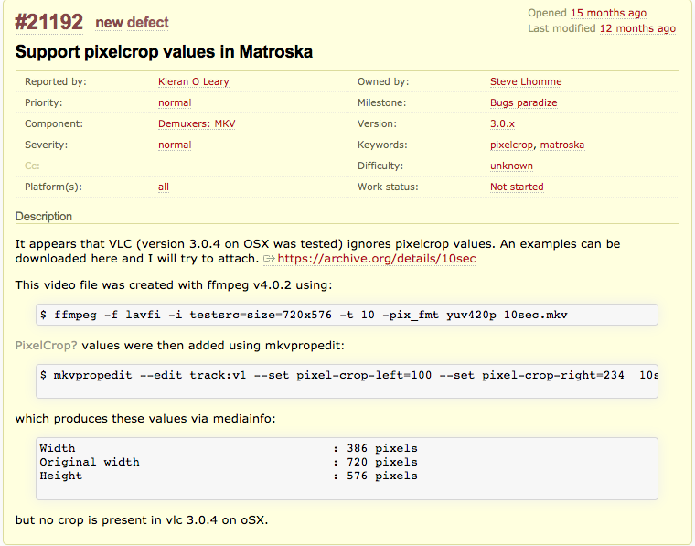

Slide 14
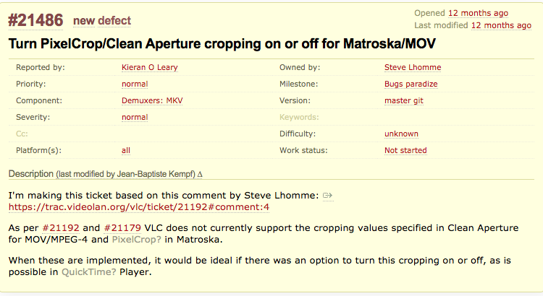

Slide 15
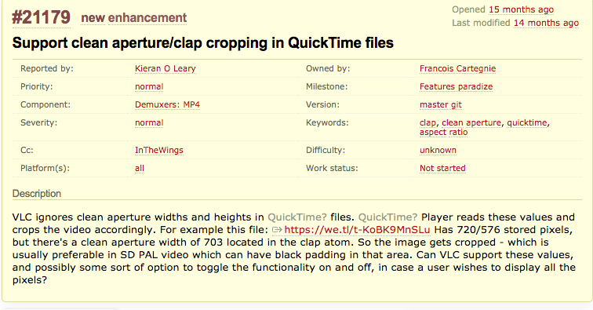

Slide 16
IFI outcome
We preserve ProRes within MOV for now
ProRes is capable of self-description in ways FFV1 is not
VLC needs improvements for handling MOV/MKV
Most likely not an appropriate migration YET - Could change in the future
Report display issues in MOV/MKV in VLC and hopefully financially support a fix
Report clean aperture metadata mapping between MOV and Matroska
Focus more on improving the decoding and display tools rather than changing formats
This is not a failed exercise, it’s a process of continual improvement
Lesson: Report issues and fund improvements!

